Slide 1
RANDOM FOREST BASED WEARABLE WRISTBAND FOR OVERNIGHT SLEEP APNEA MONITORING USING PPG AND MOTION SENSING
Team Members:
Prabal Koirala (THA079BEI019) Prasan Gautam (THA079BEI022) Prashant Bhusal (THA079BEI024) Pratik Khatiwada (THA079BEI025)
Supervised By:
Er. Pradip Prasad Sah
Department of Electronics and Computer Engineering Institute of Engineering, Thapathali Campus
March 2026

Slide 2
Presentation Outline
Motivation
Introduction
Objectives
Project Applications
Scope Of Project
Methodology
Result
Analysis
Future Enhancements
Conclusion
References
2

Slide 3
Motivation
Growing demand exists for affordable, accessible tools enabling regular sleep apnea screening
Clinical studies provide accuracy but remain costly while wearables lack medical reliability
Reliable overnight data collection requires local storage without continuous internet access
Automated analysis using machine learning enables objective detection of apnea events

Slide 4
Introduction
Sleep apnea is a rapidly growing global burden, driven by aging populations, obesity, and sedentary lifestyles, yet remains critically underdiagnosed due to the cost and inaccessibility of clinical polysomnography
Advances in wearable PPG/IMU sensors and machine learning have improved physiological signal analysis, yet affordable and clinically reliable home-based apnea detection remains unachieved
This project develops a wrist-worn PPG and IMU system with embedded ML to detect apnea events overnight and generate daily web reports with AHI severity indices

Slide 5
Objectives
To collect and analyze PPG data during sleep using a wristband and machine learning to generate daily sleep report detecting apnea
To provide an affordable, non-invasive solution for continuous sleep monitoring and early medical intervention

Slide 6
Scope Of Project
Continuous overnight monitoring of heart rate, blood oxygen SpO₂ and wrist motion using PPG and IMU sensors
Machine Learning-based classification of apnea events to generate daily web summaries and severity indices (AHI)

Slide 7
Project Applications
Early Detection of Sleep Apnea
Home-Based Sleep Monitoring
Provides an affordable alternative to traditional sleep labs, making sleep apnea screening accessible to a larger population

Slide 8
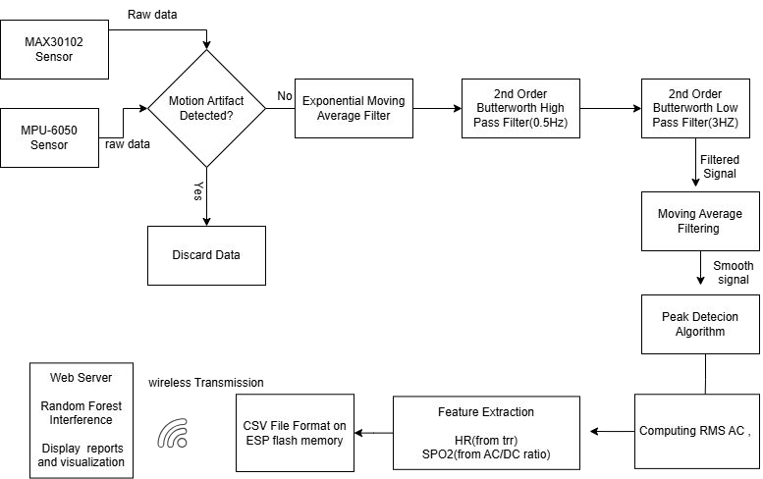
Methodology - [1]
(System Block Diagram)

Slide 9
Methodology - [2] (Working Principle)
ESP32-S3 microcontroller coordinates the MAX30102 and MPU6050 IMU sensors
PPG sensor captures heart rate and blood oxygen saturation SpO₂ data
IMU sensor tracks tri-axial wrist motion to identify and gate motion artifacts
All records are stored in the flash memory of ES32
Wi-Fi module transmits processed session data to a web server for analysis

Slide 10
Methodology - [3] (Operational Workflow)
Butterworth filtering removes baseline drift and high-frequency noise from raw PPG signals
Motion gating discards PPG segments corrupted by significant wrist movement
Feature extraction derives heart rate variability and SpO₂ levels from smoothed waveforms
Random Forest model classifies each-second segments into normal or apnea events
Temporal aggregation groups consecutive detections to confirm sustained apnea events

Slide 11
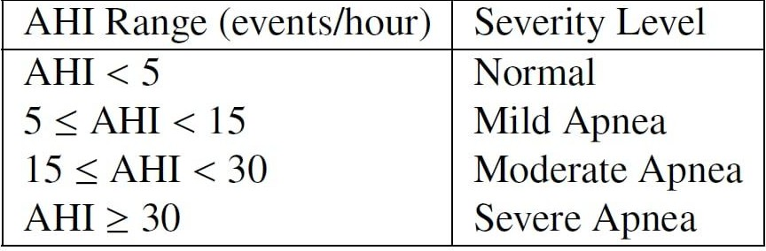
Methodology - [3] (Operational Workflow)
AHI calculation quantifies the severity of sleep apnea based on hourly event counts
Web dashboard visualizes time-series data and generates daily sleep quality reports

Slide 12
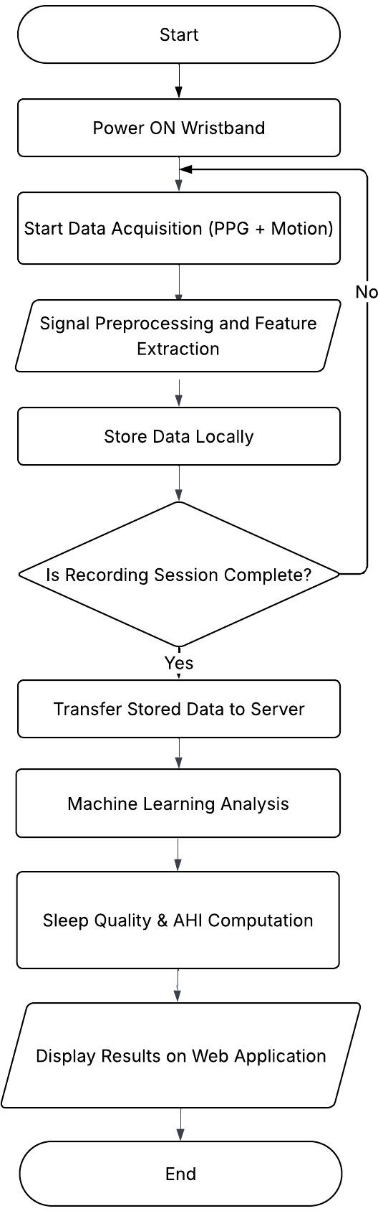
Methodology - [4]
(Flow Of Proposed System)

Slide 13
Methodology - [5] (Hardware Requirement)
ESP32-S3 Microcontroller
MAX30102 PPG Sensor
MPU6050 IMU Module
Rechargeable Battery
Boost Converter

Slide 14
Methodology - [6] (Software Requirement)
Arduino IDE
Python
Flask
Scikit-learn
Git / Github
Matlab

Slide 15
Methodology - [7] (Machine Learning Architecture)
Random Forest is a machine learning technique that uses many decision trees instead of just one
Each tree is trained on a different subset of the data
The final prediction is made by combining the results of all trees
This approach helps reduce overfitting and improves generalization

Slide 16
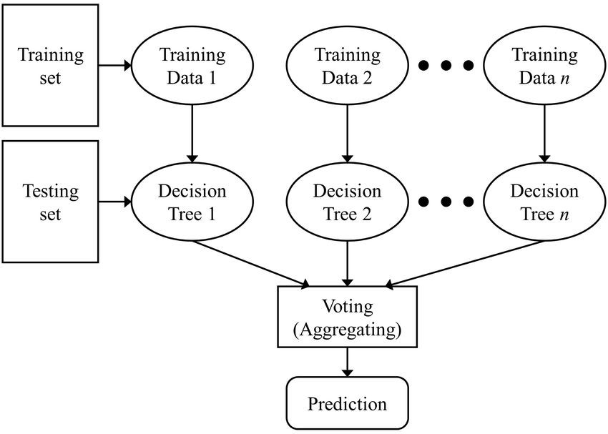
Methodology - [8] (Random Forest Architecture)

Slide 17
Methodology - [9] (Dataset Preparation)
Data sourced from the ScienceDB multimodal sleep apnea dataset
Focus on continuous HR and SpO₂ saturation levels
Labeled each window as apnea (1) or normal (0) based on clinical annotations.
Extracted 12 handcrafted features: HR stats, SpO₂ stats, and cross-signal features.
Dataset was splitted into train / validation / test sets at the patient level to
3/23/2026prevent data leakage.
17

Slide 18
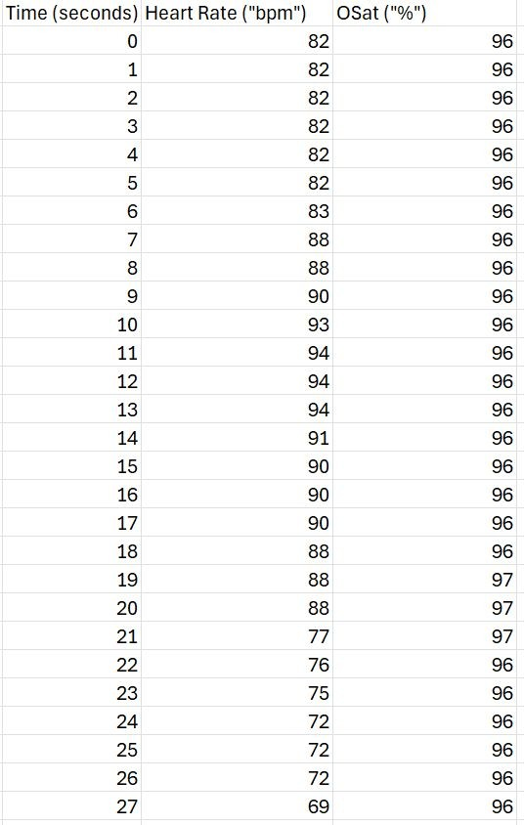
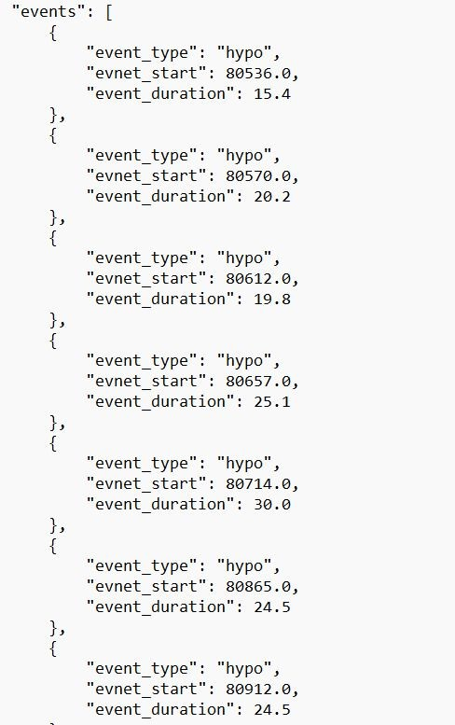
Methodology - [10]
(Snapshot of Dataset)

Slide 19
Methodology - [11] (Model Training)
Trained a Random Forest classifier on 12 extracted HR and SpO₂ features.
Applied class weighting to compensate for apnea/normal class imbalance.
Tuned the decision threshold on the validation set to maximise F1 score.
Final model was evulated on the held-out test set of 10 unseen patients.
Serialize trained model to a .joblib file and deploy on Flask web server for inference.

Slide 20
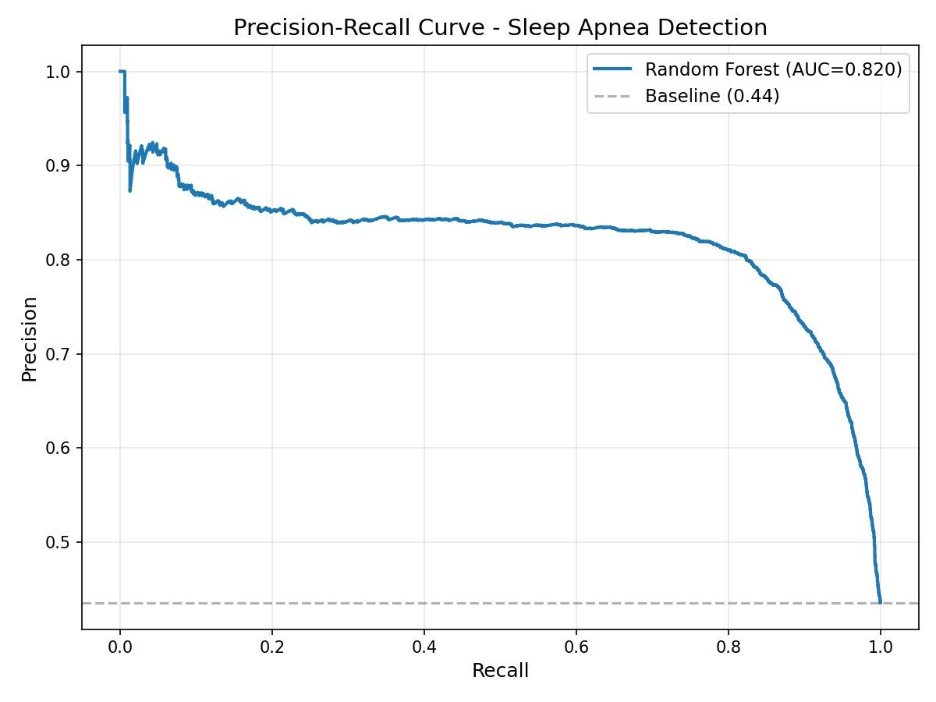
Result[1] (Precision-Recall Curve)

Slide 21
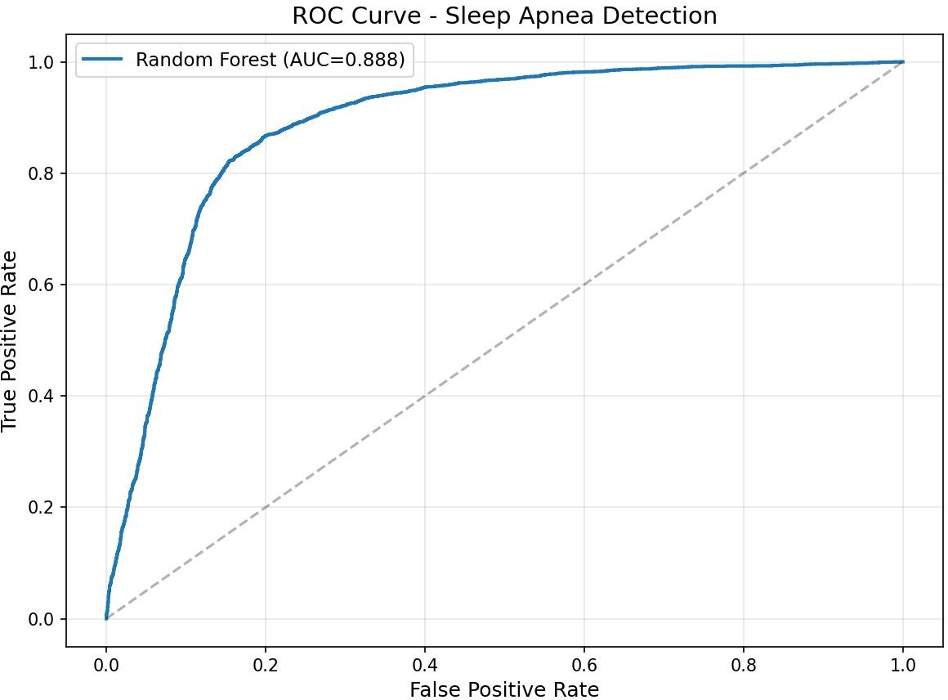
Result[2] (ROC Curve)

Slide 22
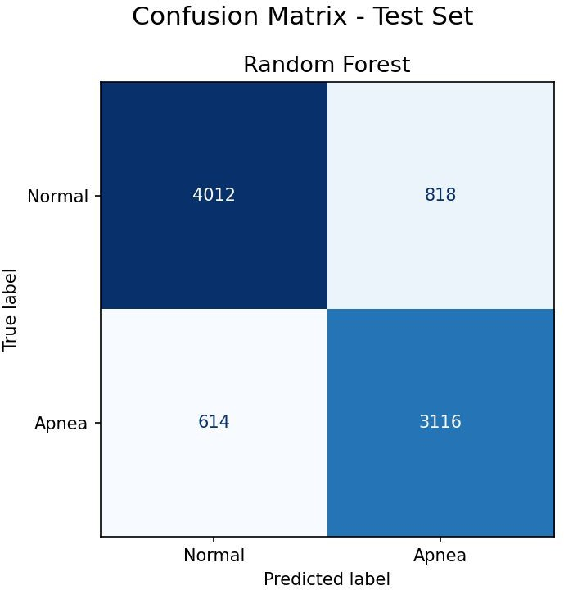
Result[3] (Confusion Matrix)
Out of 3,730 actual apnea windows:
3,116 correctly detected as apnea
614 missed (false negatives)
Out of 4,830 actual normal windows:
4,012 correctly identified as normal
818 wrongly flagged as apnea (false positives)
Accuracy ≈ 83%
Precision ≈ 79%
Recall ≈ 83%

Slide 23
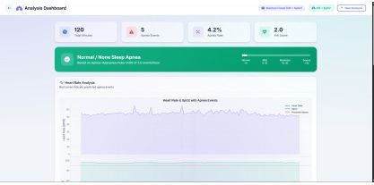
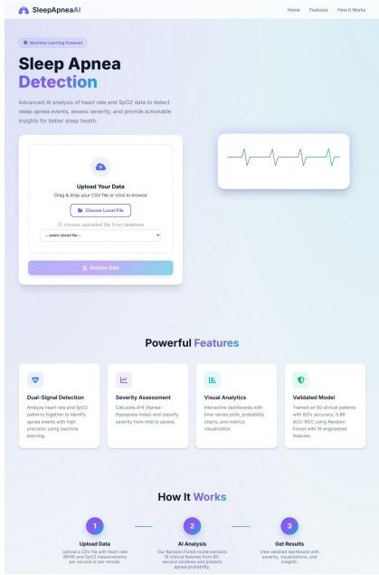
Result[4]
Dashboard for Data Visualization, generating each day reports
Homepage for web app
3/23/2026
23

Slide 24
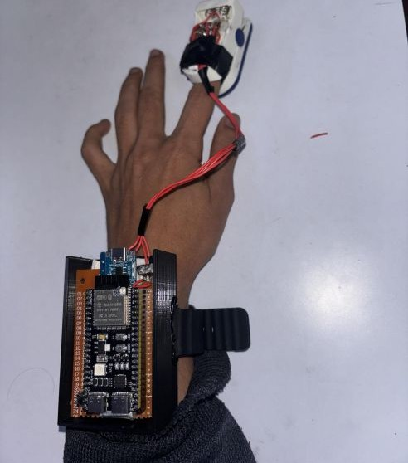
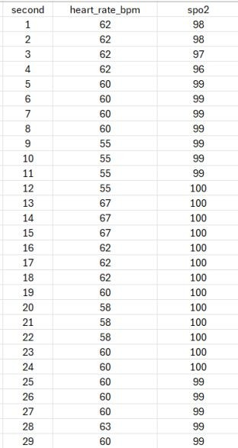
Result[5]
Final Prototype of the Sleep Apnea Monitoring System.
Data From the ESP32-S3 Microcontroller Received on the Server

Slide 25
Analysis
HR and SpO₂ Data Analysis:
Sensor detects heart beats and SpO₂ reliably once the finger is placed.
Beat intervals remained consistent, while initial SpO₂ dips reflected baseline settling.
Mean SpO₂ measured 99.5%, consistently above 95% clinical threshold.
Median heart rate stabilized at ≈69 BPM, reflecting normal resting physiology.
Measurements are continuously logged in a CSV file stored in the microcontroller’s flash memory, ensuring no data loss if Wi-Fi is unavailable

Slide 26
Future Enhancements
Train on larger, multi-center datasets across diverse age groups, body types, and apnea severities to improve real-world reliability and population-level generalization
Replace the window-independent Random Forest with sequential models to capture long-term apnea patterns and improve event recall
Deploy the ML model directly on the ESP32-S3 using TensorFlow Lite to eliminate server dependency and enable real-time overnight feedback

Slide 27
Conclusion
The proposed wristband system successfully integrates PPG and IMU sensors on ESP32-S3.
Reliable acquisition of heart rate and SpO₂ achieved with robust signal processing.
Motion artifact rejection and local storage ensured stable overnight monitoring without data loss.
Random Forest classifier delivered ≈83% accuracy, enabling dependable apnea event detection.
Web dashboard provides daily AHI severity reports, supporting affordable home-based sleep screening.
Project demonstrates a clinically relevant, low-cost solution for early detection of sleep apnea.

Slide 28
References
Jing Tao, Beiping Miao, Jingjing Huang, and Long Yang, “A multimodal dataset for training deep learning models aimed at detecting and analyzing sleep apnea.” Science Data Bank, Jun. 20, 2025 [Online]. Available: https://doi.org/10.57760/sciencedb.19070. [Accessed: Feb. 07, 2026]
A. Benjafield et al., ”Estimation of the global prevalence and burden of obstructive sleep apnoea: a literature-based analysis,” Lancet Respir. Med., vol. 7, no. 8, pp. 687–698, 2019

Slide 29
References(Contd..)
G. B. Papini et al., ”Wearable monitoring of sleep-disordered breathing: estimation of the apnea–hypopnea index using wrist-worn reflective photoplethysmography,” Sci. Rep., vol. 10, p. 13512, Aug. 2020
J. M. Marin et al., ”Long-term cardiovascular outcomes in men with obstructive sleep apnoea–hypopnoea with or without treatment with CPAP: an observational study,” Lancet, vol. 365, no. 9464, pp. 1046–1053, 2005

